Slide 1



User Analytics in the Telecommunication Industry

Slide 2


Index
Introduction
Project Objectives
User Overview Analysis
User Engagement Analysis
Experience Analytics
Satisfaction Analysis
Key Insights
Conclusion and Recommendations

Slide 3

Introduction
This project focuses on analyzing a telecom customer dataset to understand user engagement, experience, and satisfaction.
The goal is to generate insights on user behavior, network performance, and customer segmentation to support business decisions.

Slide 4
Project Objectives
Perform Exploratory Data Analysis (EDA) to understand user behavior.
Derive key metrics like Engagement Score, Experience Score, and Satisfaction Score.
Apply clustering techniques to group users based on similar behaviors.
Use PCA (Principal Component Analysis) to reduce dimensionality and interpret key components.
Build an interactive dashboard (Streamlit) for visualization.
Perform Model Deployment Tracking using MLflow and Docker.

Slide 5
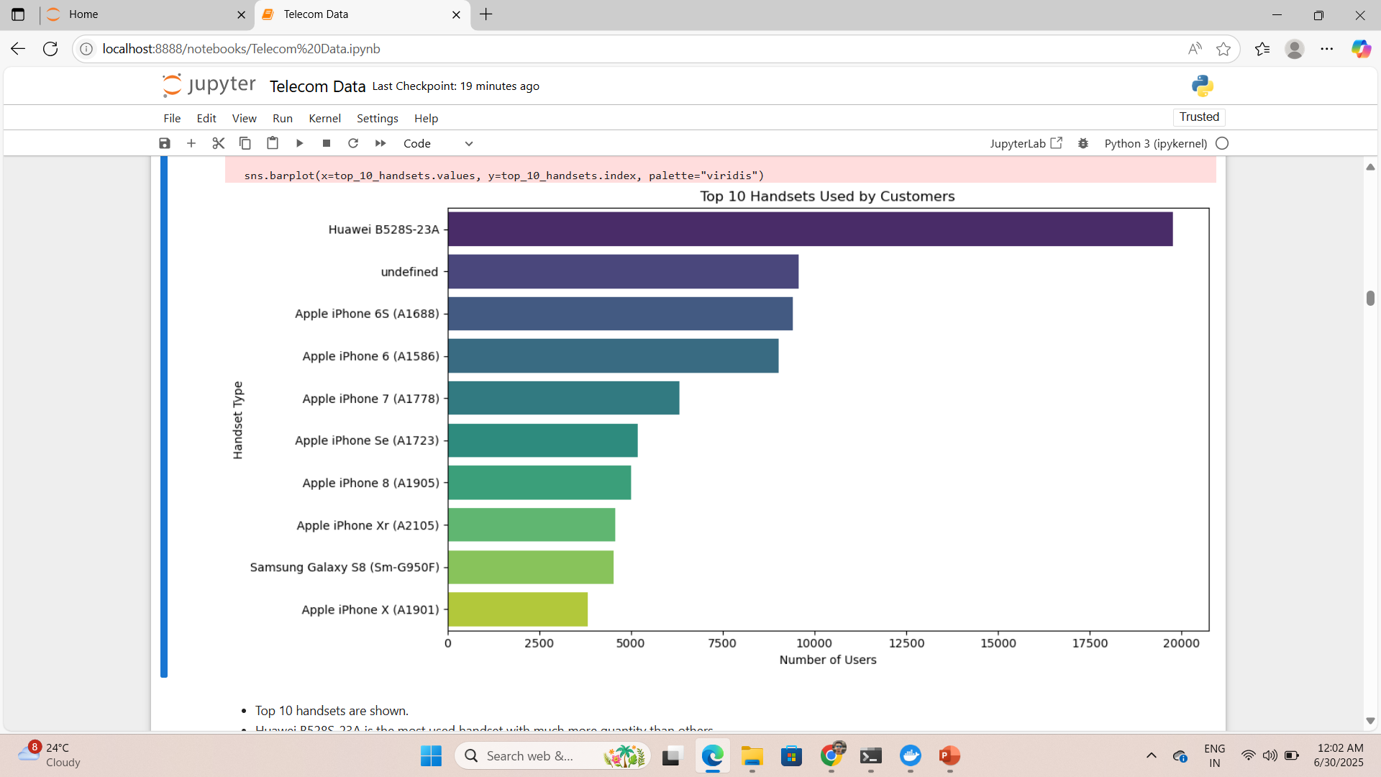
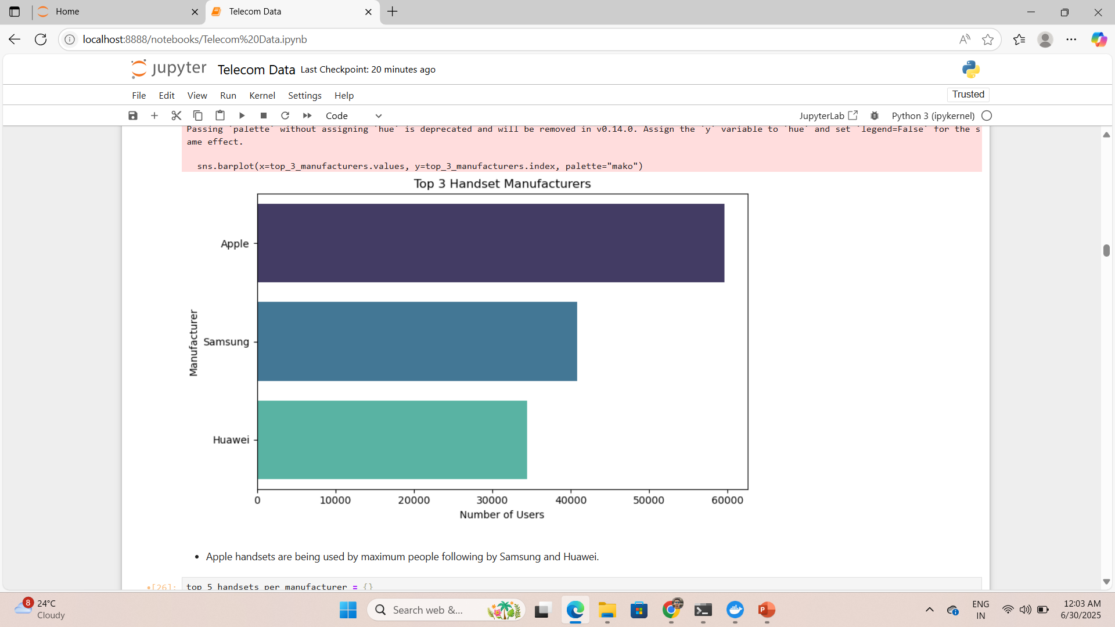
User Overview Analysis
Top 10 handsets are shown.
Huawei B528S-23A is the most used handset with much more quantity than others.
Apple handsets are being used by maximum people followed by Samsung and Huawei.

Slide 6
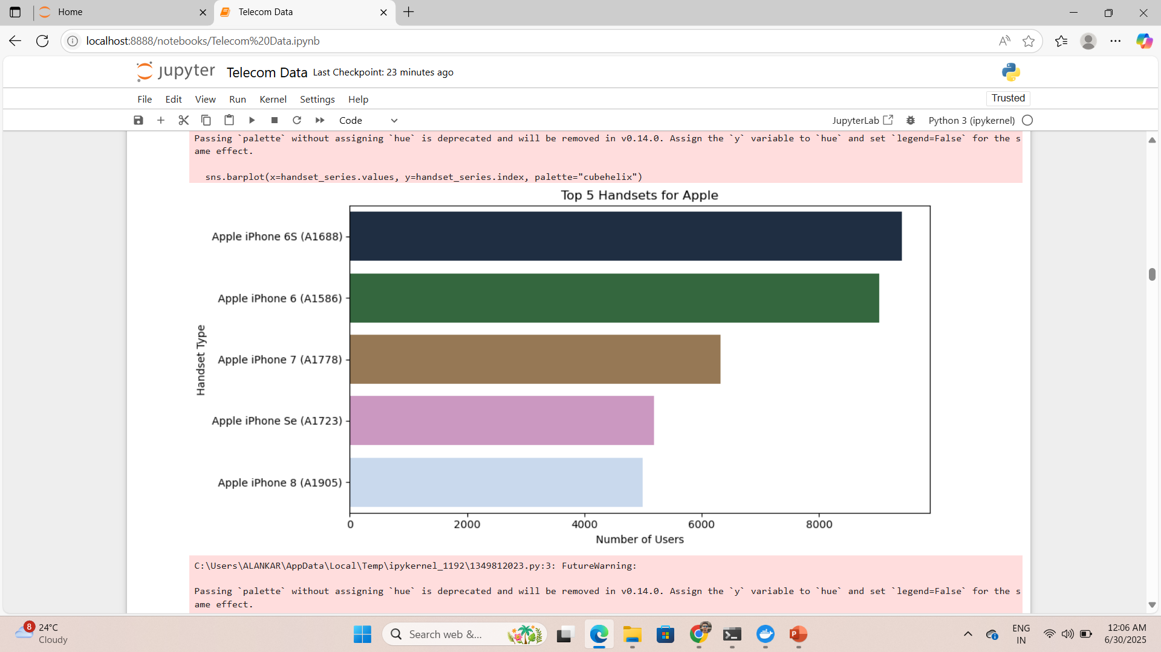
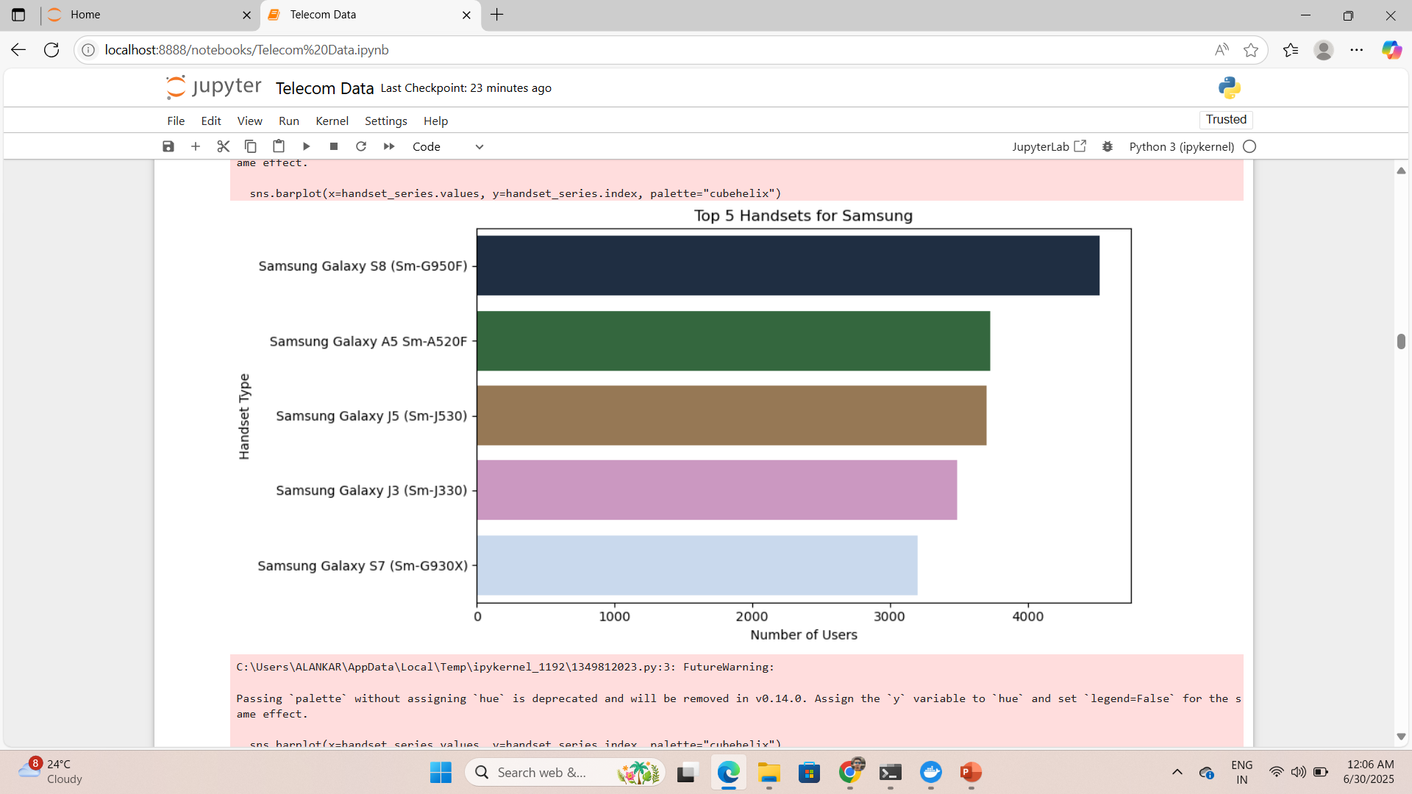
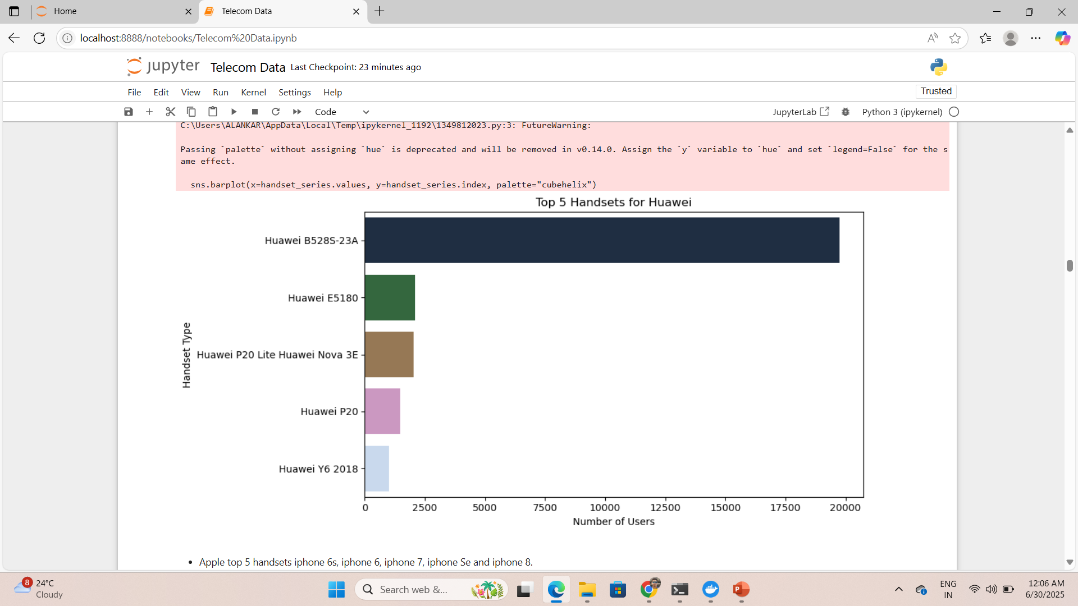
User Overview Analysis
Apple top 5 handsets iphone 6s, iphone 6, iphone 7, iphone Se and iphone 8. This indicates that a significant portion of Apple users are using older models. These users might be price-sensitive or less inclined towards upgrading frequently.
Top 5 handsets of Samsung are Galaxy S8, Galaxy A5, Galaxy J5, Galaxy J3 and Galaxy S7. A mix of mid-range (A5, J3, J5) and high-end models (S8, S7) suggests Samsung users come from diverse economic segments.
Huawei has one handset which is being used much greater than others which is B528S-23A, but other handsets are not being used much. A dominant usage of the device B528S-23A, which is a home wireless router or fixed wireless terminal device, not a smartphone.

Slide 7
Recommendation
Apple:
Launch upgrade campaigns targeting users with older models (iPhone 6/6s/SE).
Offer trade-in offers, discounts, or data bundle incentives to encourage migration to newer iPhones.
2. Samsung:
Develop tiered offers:
Premium data plans for high-end users (S7, S8).
Affordable bundles and loyalty rewards for mid-range users (A5, J3, J5).
Opportunity to upsell mid-range users to higher-end models.
3. Huawei:
Focus on home broadband packages, router upgrades, and loyalty offers since the primary usage is fixed wireless.
Introduce offers for smartphone adoption if expansion into mobile devices is a goal.

Slide 8
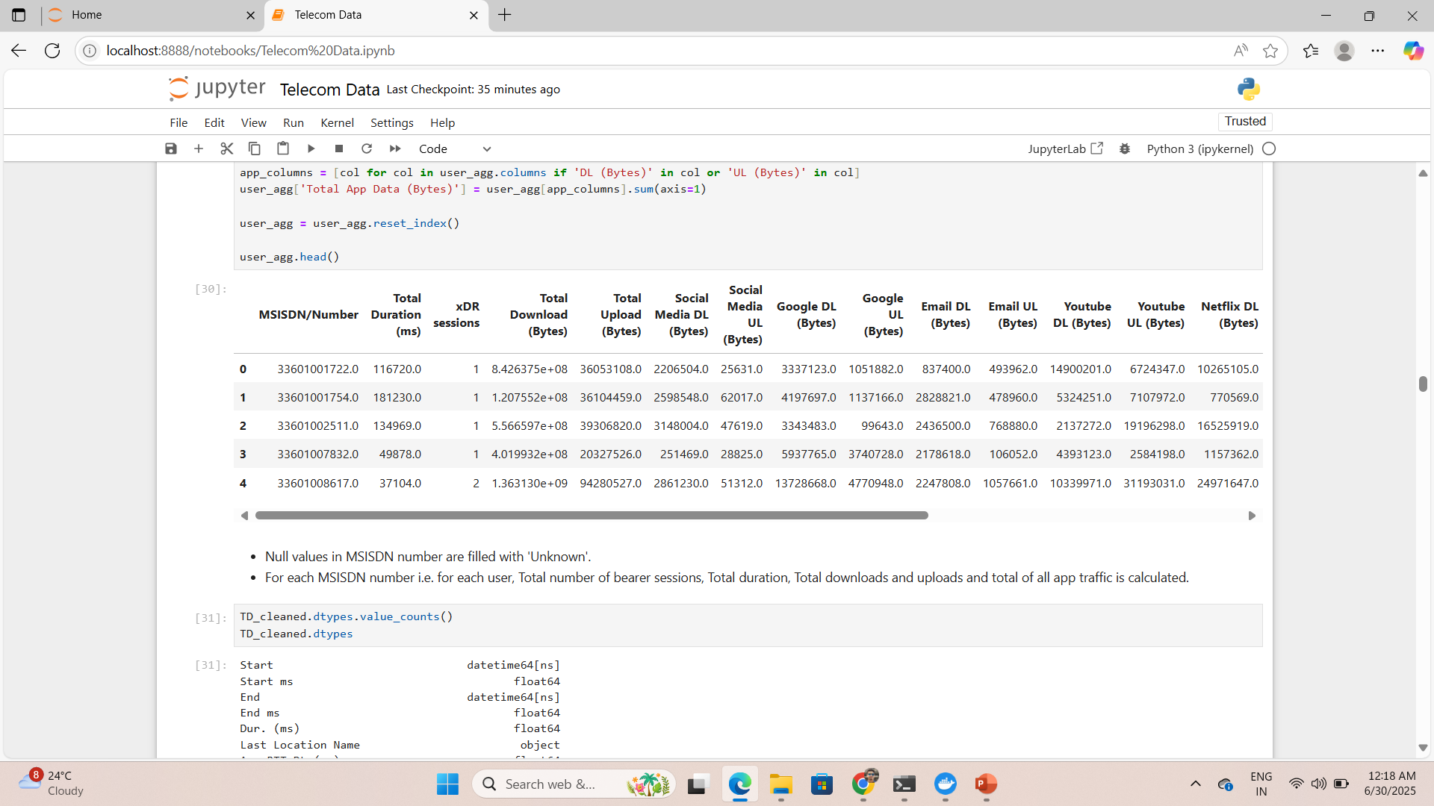
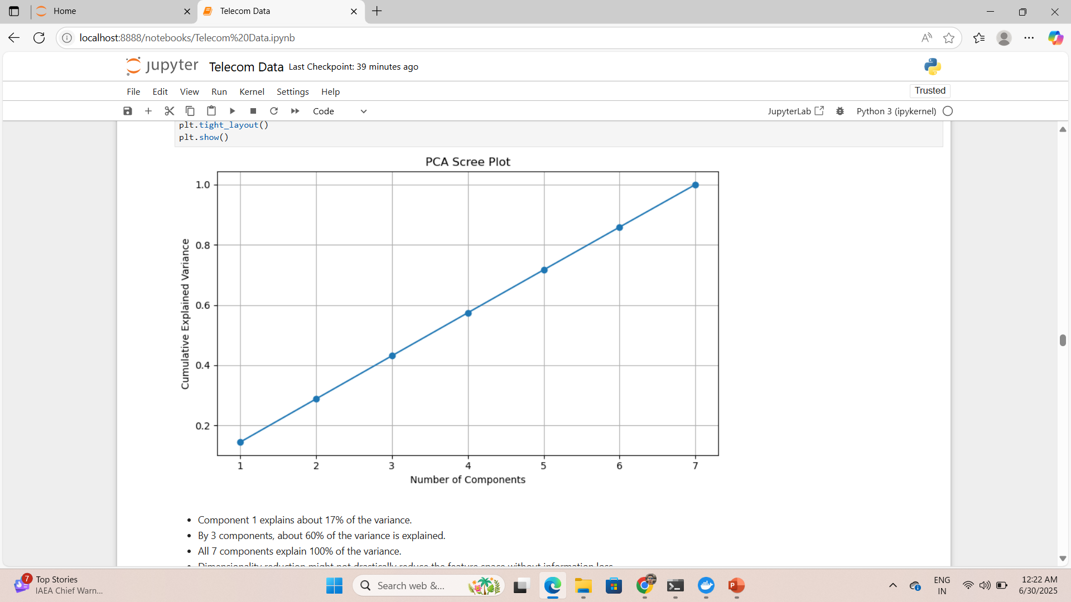
User Overview Analysis
For each MSISDN number i.e. for each user, Total number of bearer sessions, Total duration, Total downloads and uploads and total of all app traffic is calculated.
Component 1 explains about 17% of the variance.
By 3 components, about 60% of the variance is explained.
All 7 components explain 100% of the variance.

Slide 9
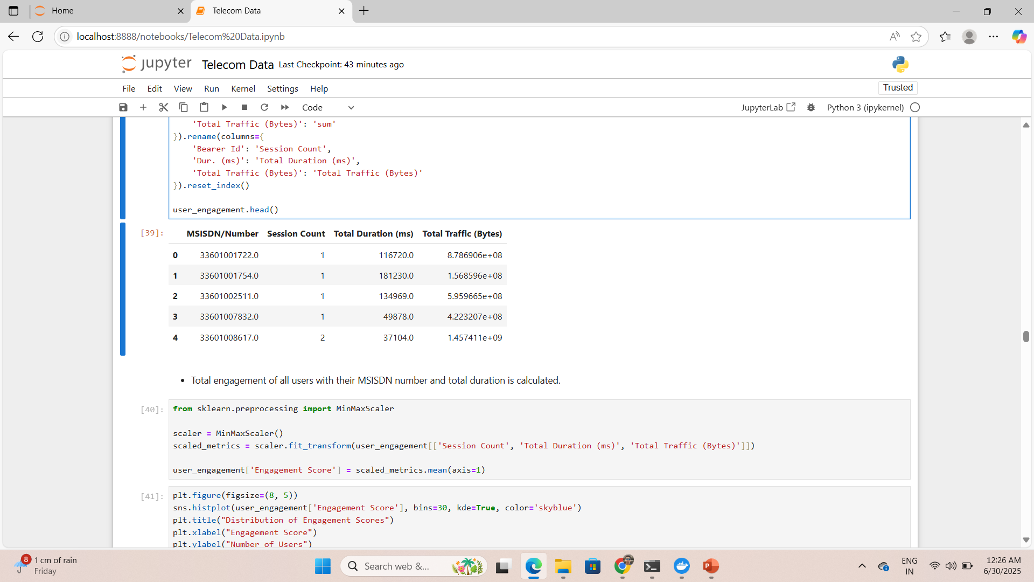
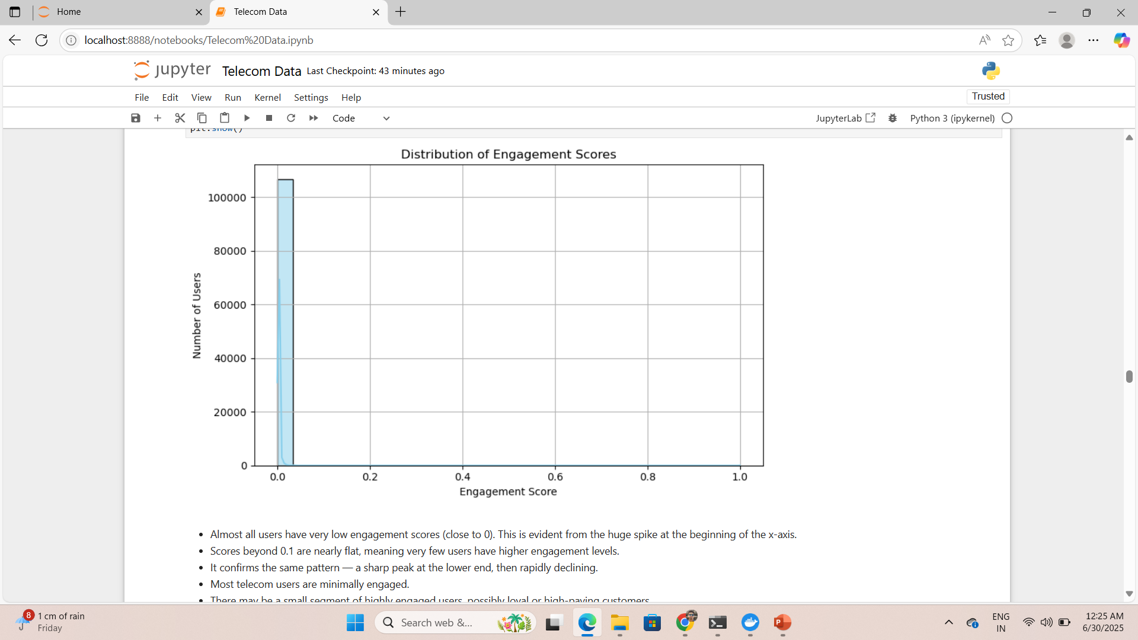
User Engagement Analysis
Almost all users have very low engagement scores (close to 0). This is evident from the huge spike at the beginning of the x-axis.
Scores beyond 0.1 are nearly flat, meaning very few users have higher engagement levels.
It confirms the same pattern — a sharp peak at the lower end, then rapidly declining.
Most telecom users are minimally engaged.
There may be a small segment of highly engaged users, possibly loyal or high-paying customers.

Slide 10
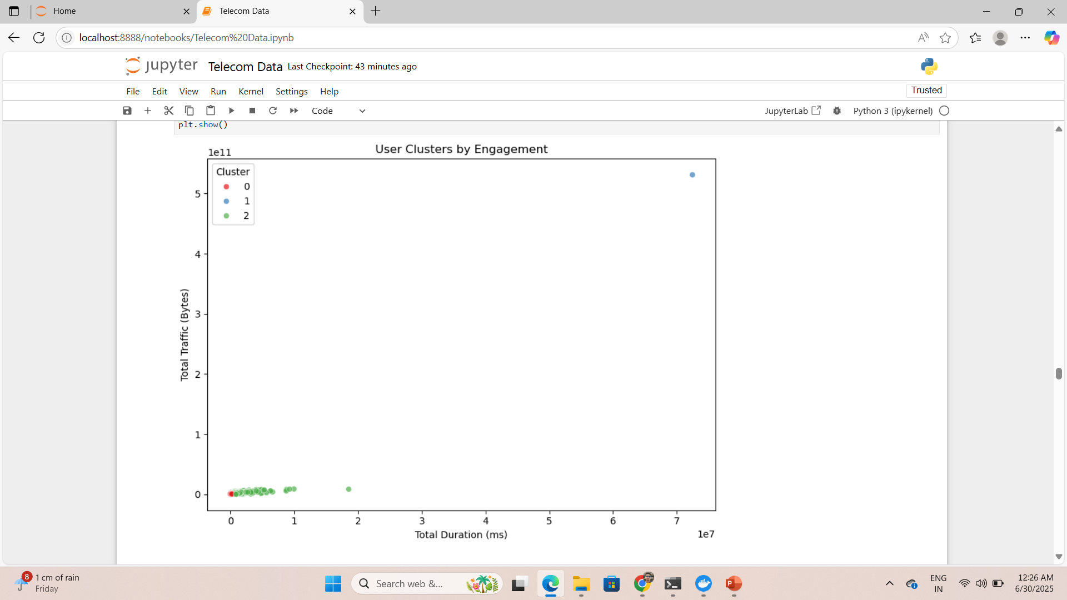
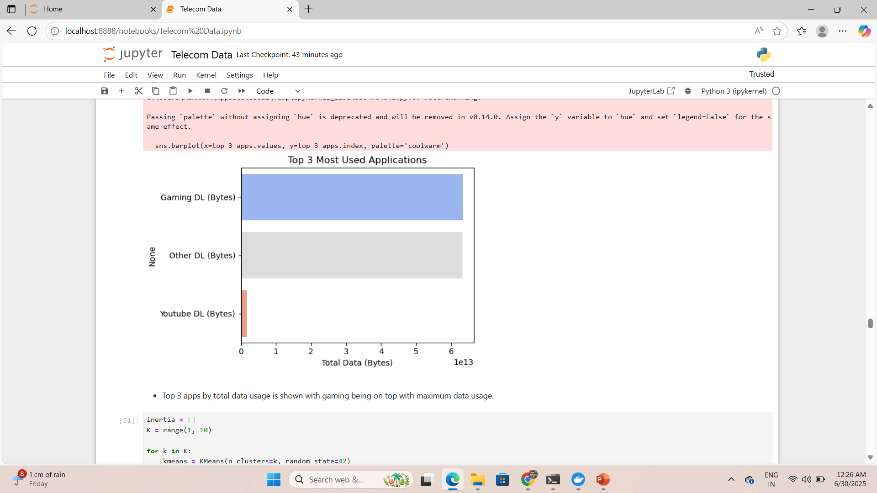
User Engagement Analysis
Cluster 0 (Red): Likely inactive or disengaged users.
Cluster 1 (Blue): A single, extreme outlier with very high traffic and usage duration. This is a super engaged power user.
Cluster 2 (Green): Most users fall here. Moderate duration and traffic. Likely average/typical users with regular engagement.
Top 3 apps by total data usage is shown with gaming being on top with maximum data usage.

Slide 11
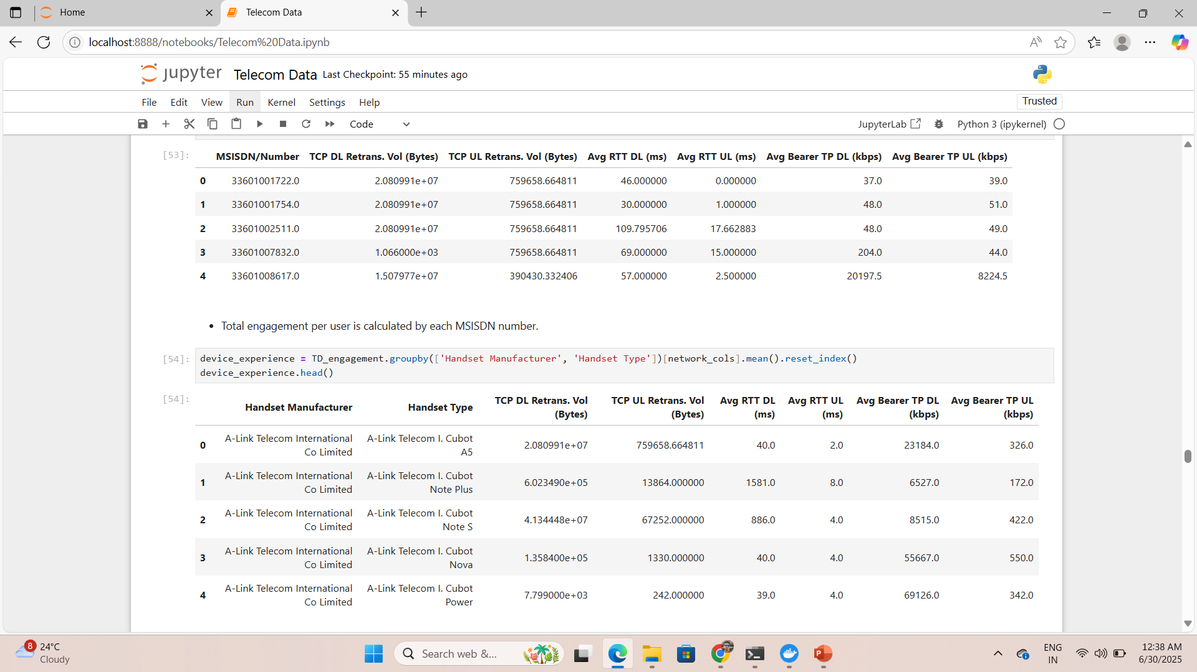
User Engagement Analysis
Total engagement per user is calculated by each MSISDN number.
Total engagement per manufacturer and per handset is calculated with each name.

Slide 12
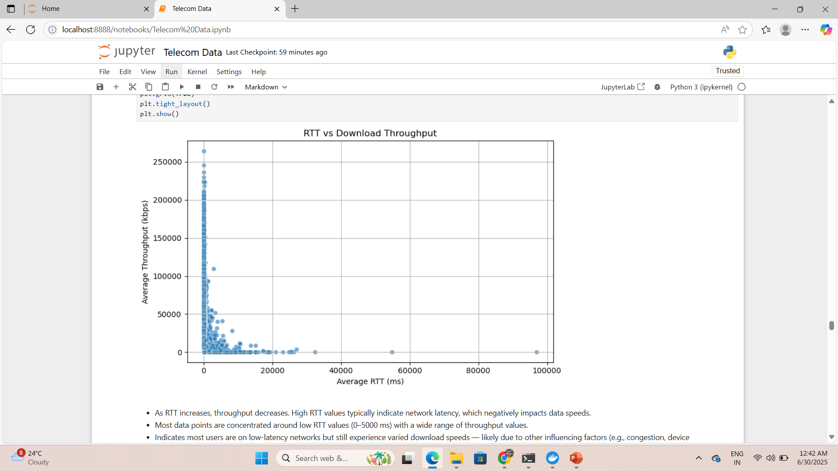
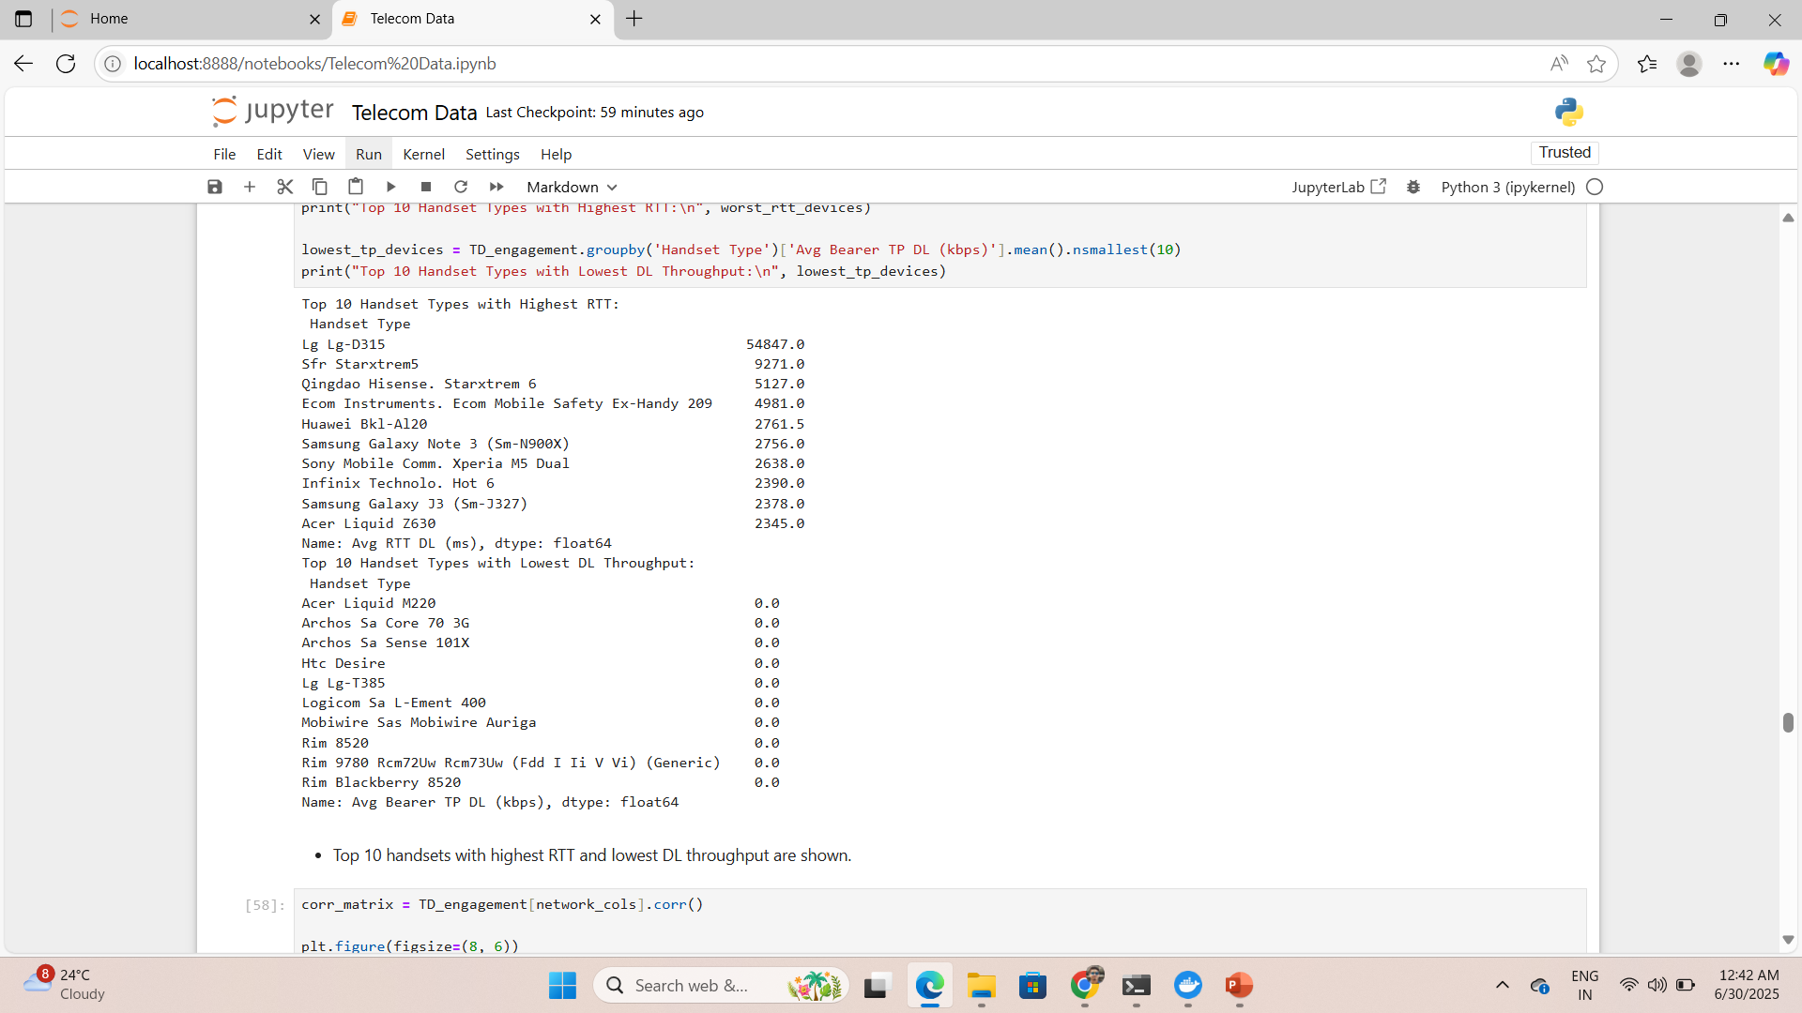
User Engagement Analysis
Most data points are concentrated around low RTT values (0–5000 ms) with a wide range of throughput values.
Indicates most users are on low-latency networks but still experience varied download speeds — likely due to other influencing factors (e.g., congestion, device capability).
Very few users have RTT values above 20,000 ms. These users experience extremely low throughput, indicating very poor connection quality.
Top 10 handsets with highest RTT and lowest DL throughput are shown.

Slide 13
Insights
RTT and Throughput have inverse relationship.
TCP retransmission volume is high for certain users—may indicate bad connection quality.
Certain handsets consistently show poor network KPIs—may need optimization.
Clustering helps identify poor experience users to focus network improvement.

Slide 14
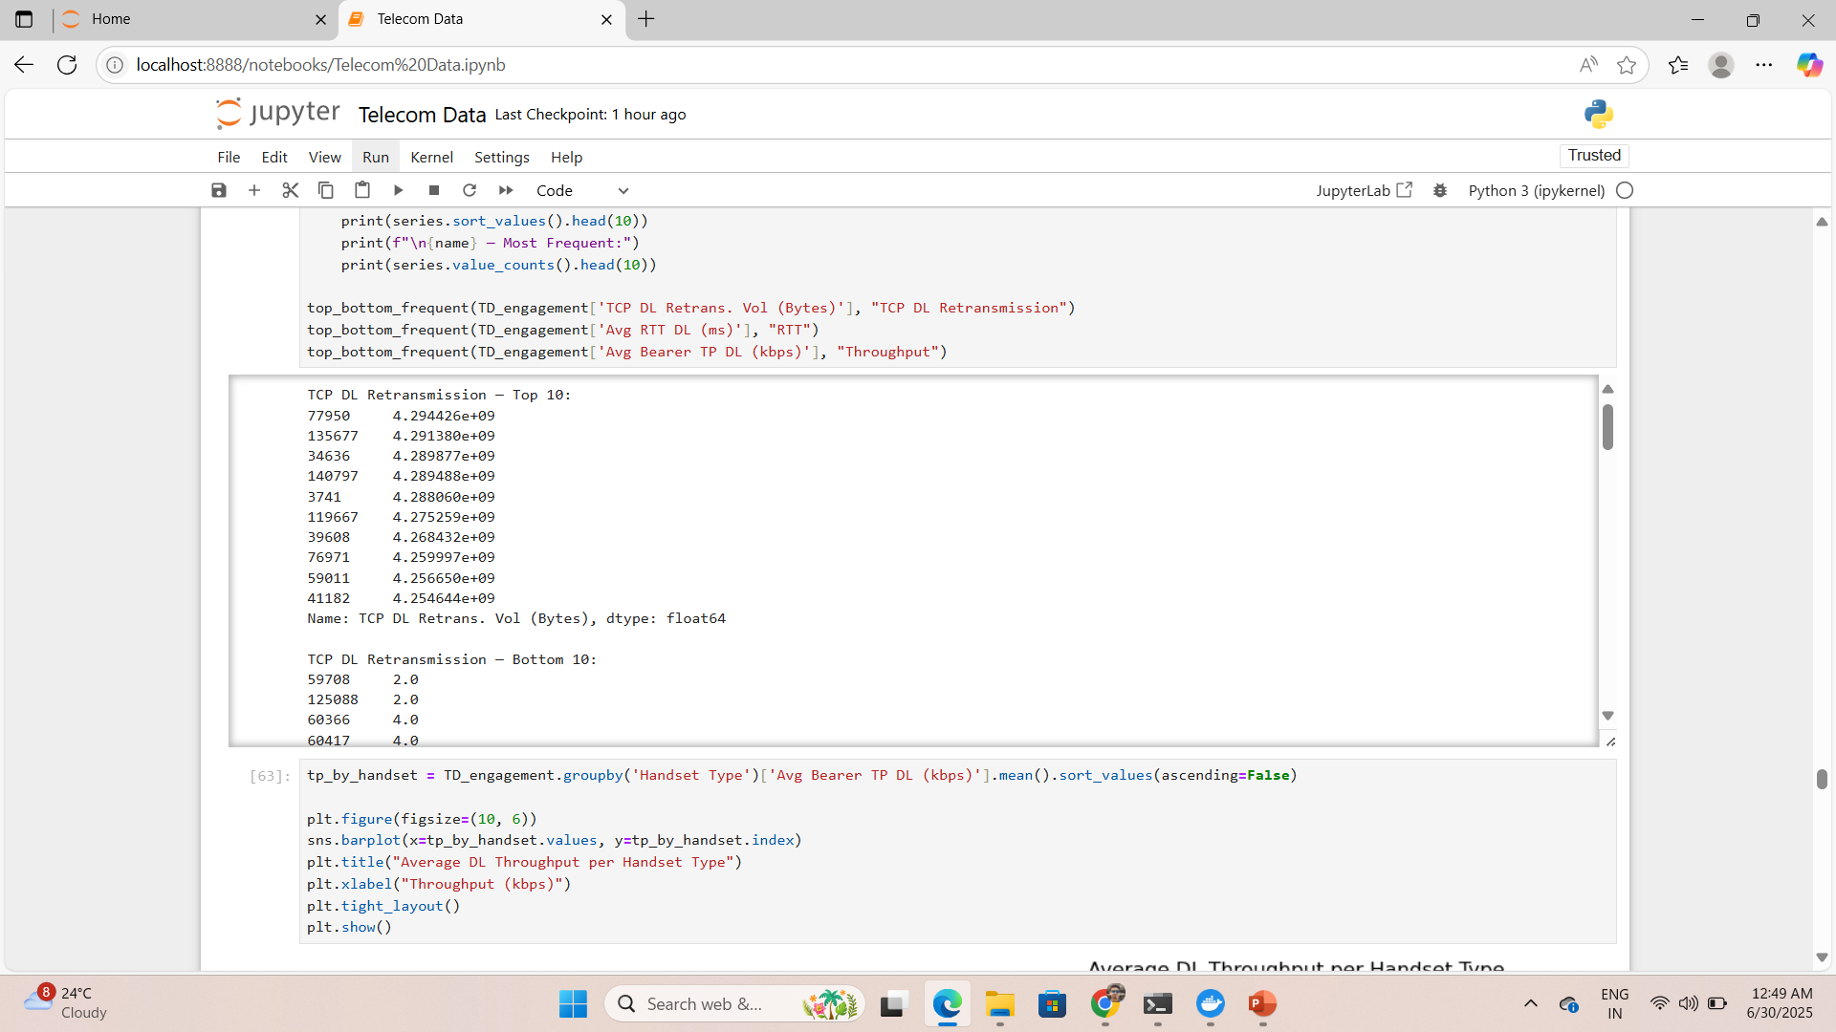
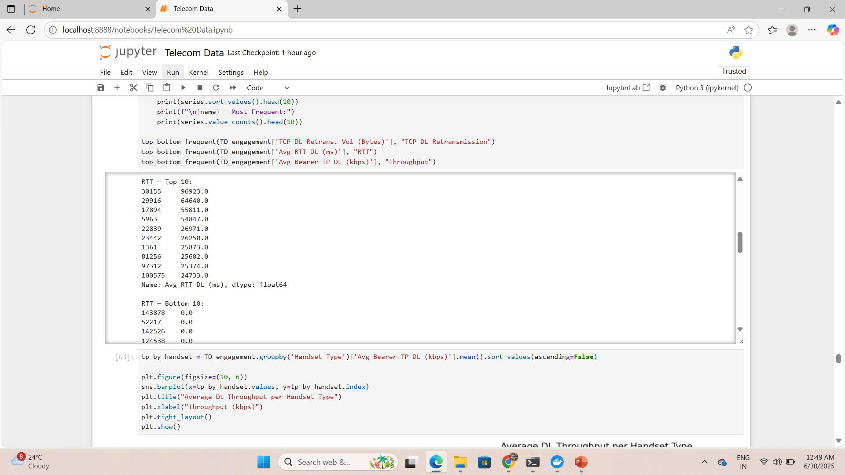

Experience Analytics
TCP DL Retransmission
RTT
Throughput

Slide 15
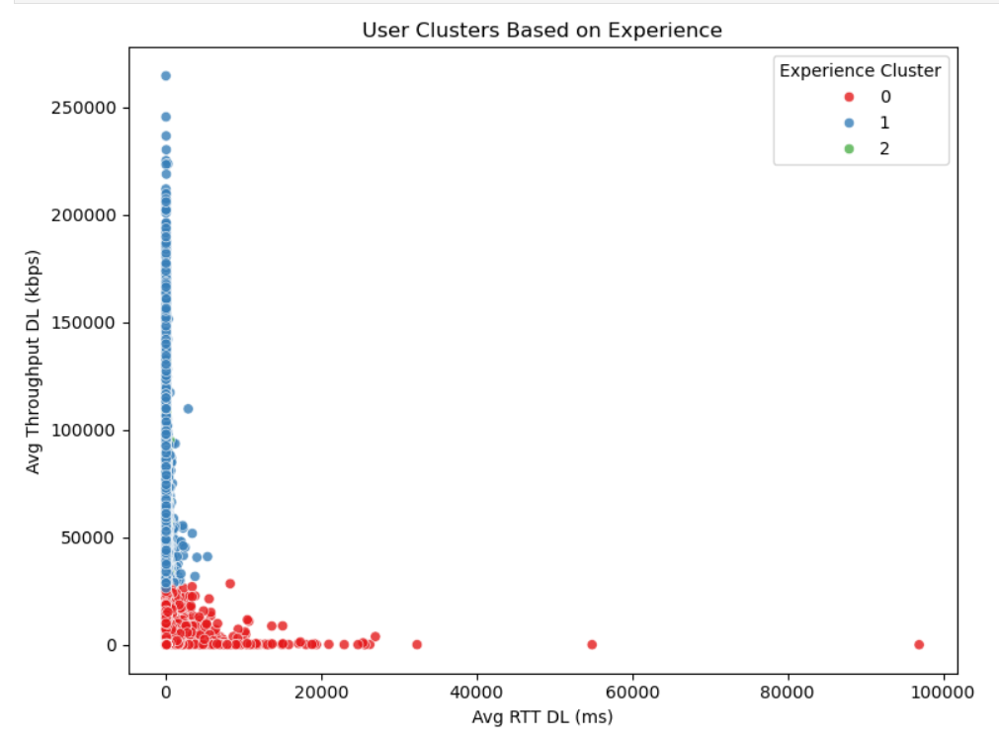
Experience Analytics
Cluster 0 (red): Low throughput & high RTT → Worst experience. Likely experiencing slow speeds and high latency.
Cluster 1 (blue): Moderate throughput & low RTT → Average experience. Balanced but not ideal performance.
Cluster 2 (greene): High throughput & low RTT → Best experience. Fast network, low delays — possibly premium or urban users.

Slide 16
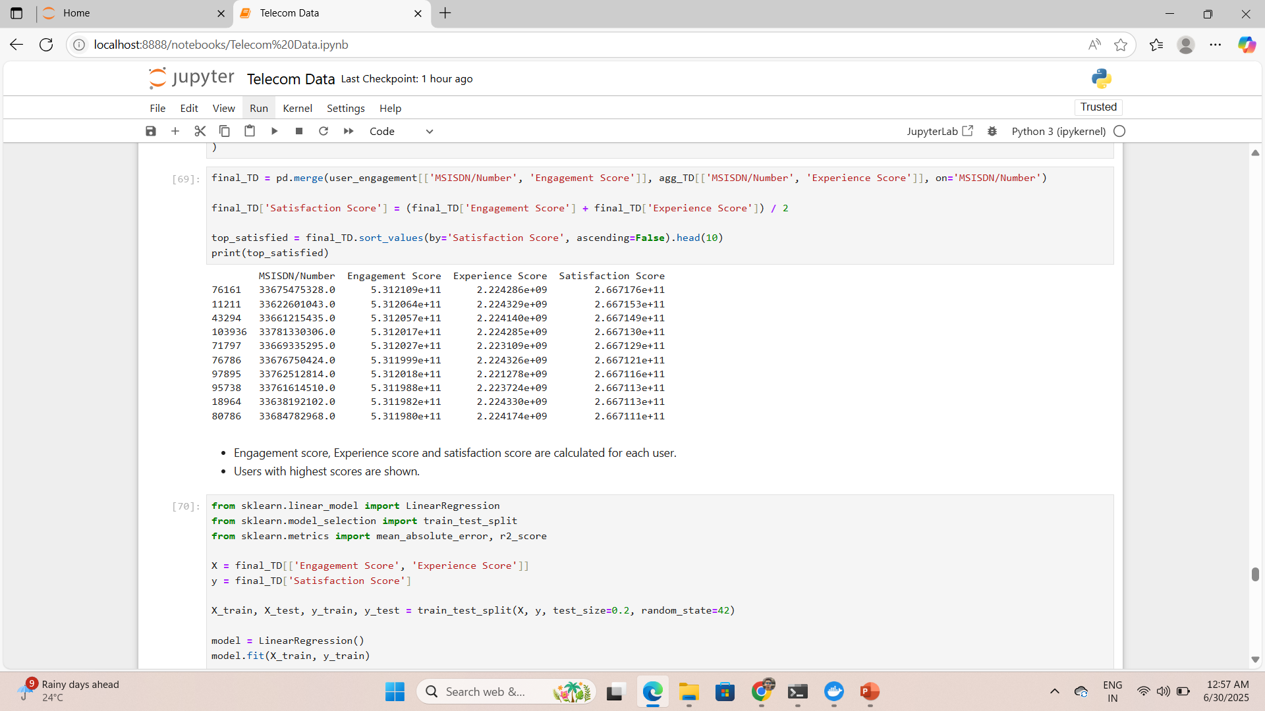
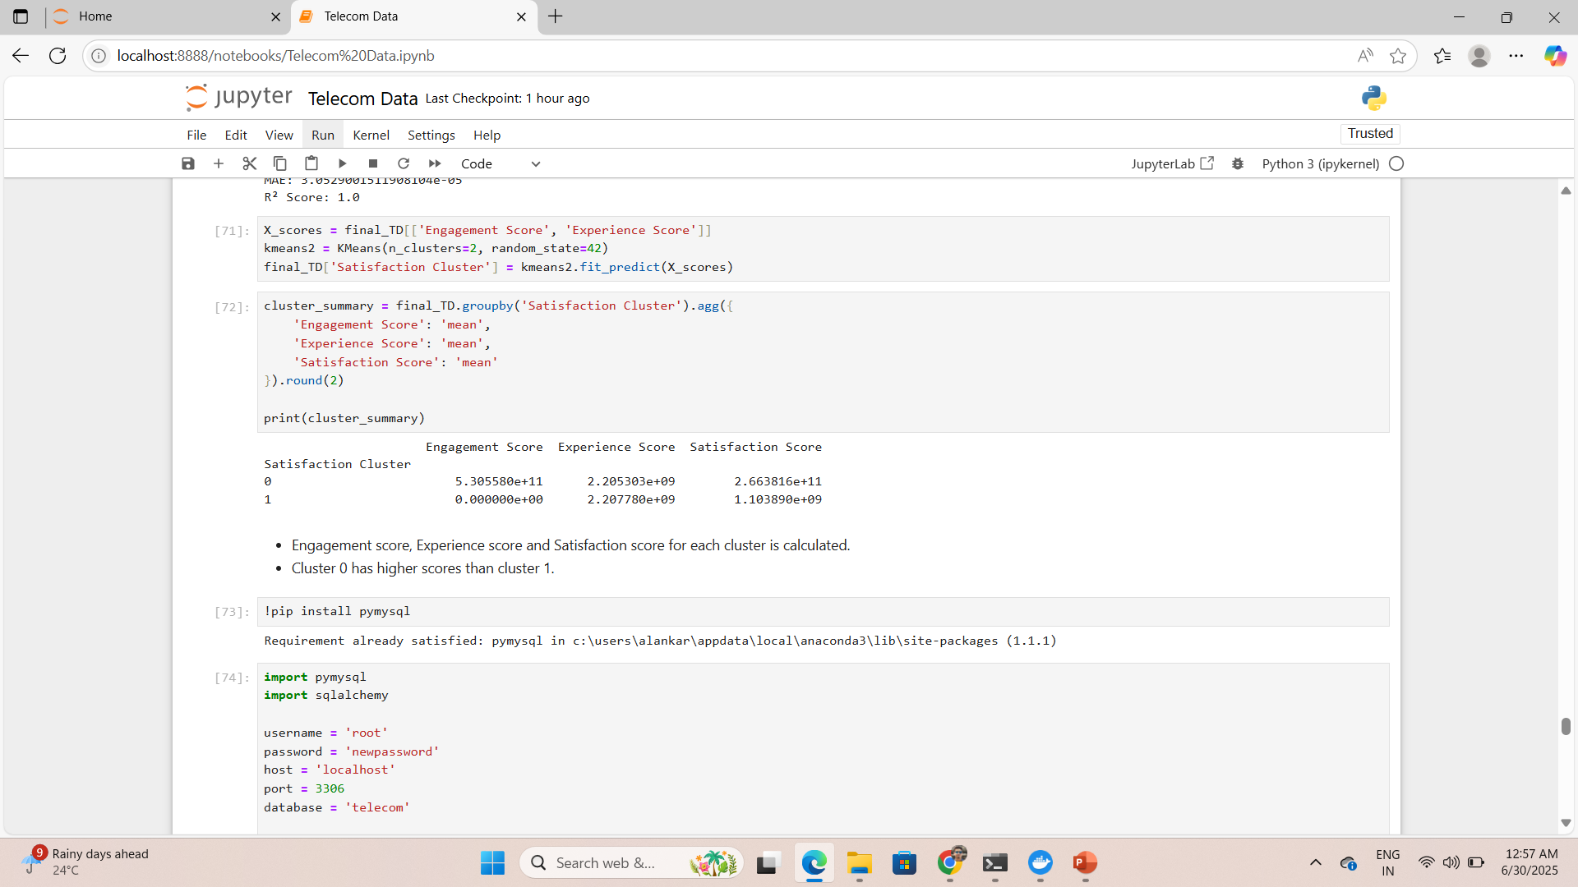
Satisfaction Analysis
Engagement score, Experience score and satisfaction score are calculated for each user.
Users with highest scores are shown.
Engagement score, Experience score and Satisfaction score for each cluster is calculated.
Cluster 0 has higher scores than cluster 1.

Slide 17
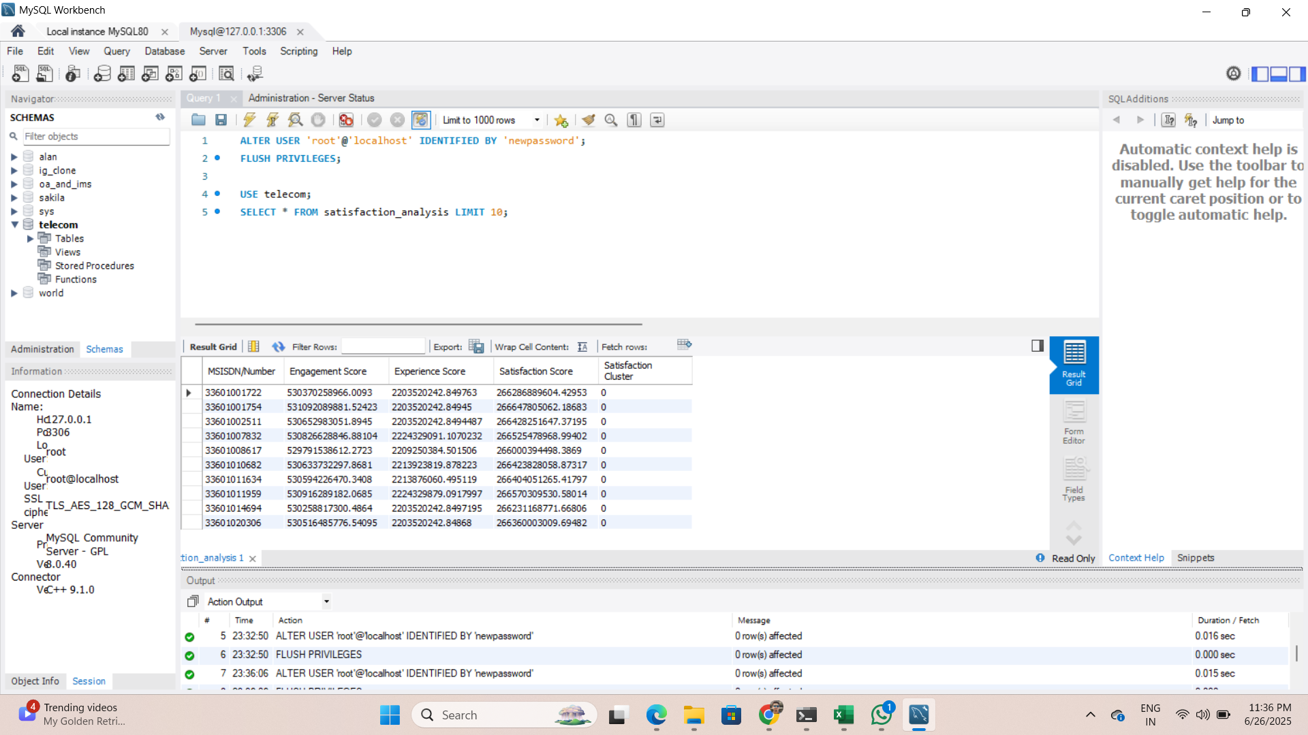
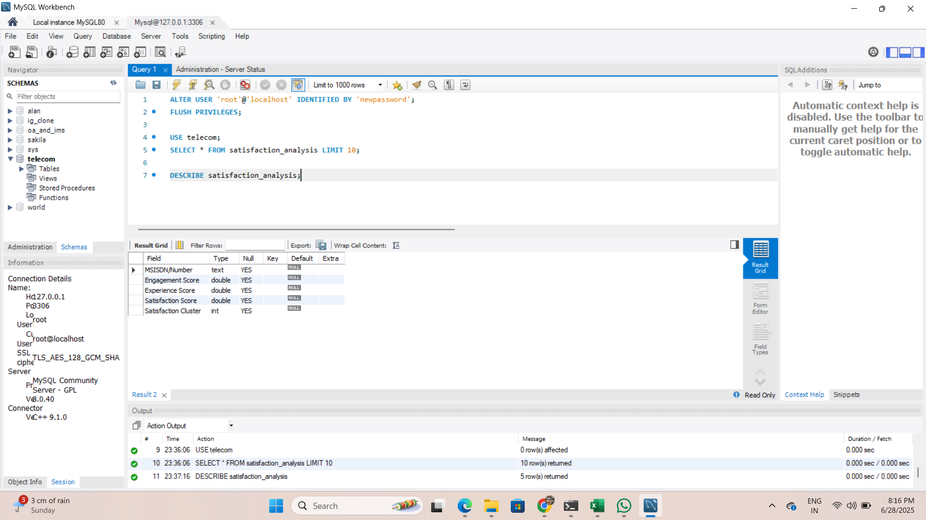
Satisfaction Analysis
SQL queries show the Engagement score, Experience Score, Satisfaction Score and particular satisfaction cluster for each user.
Description of All the variables is also shown.

Slide 18
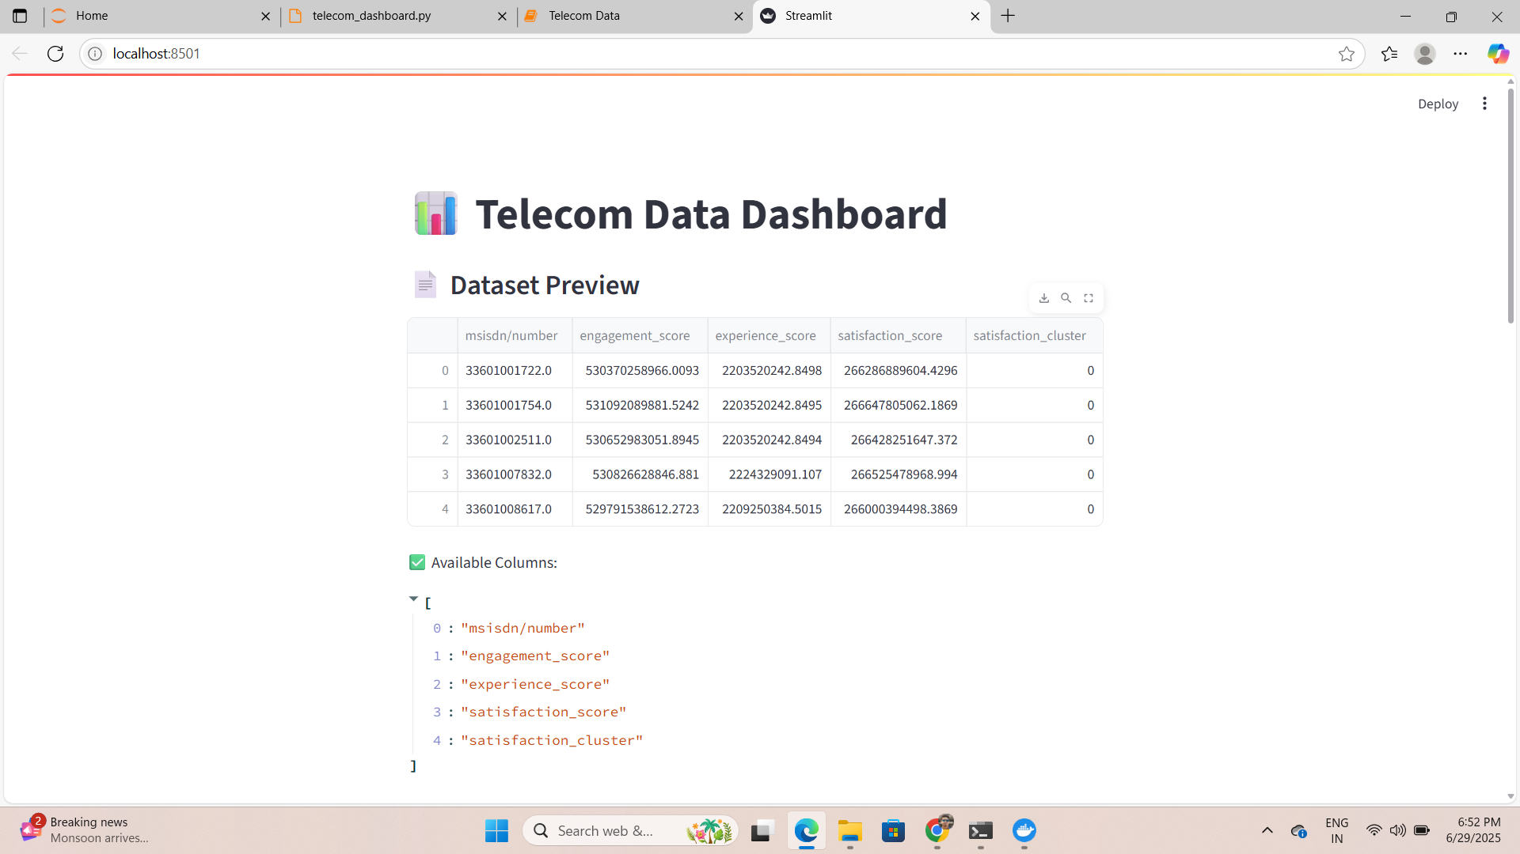
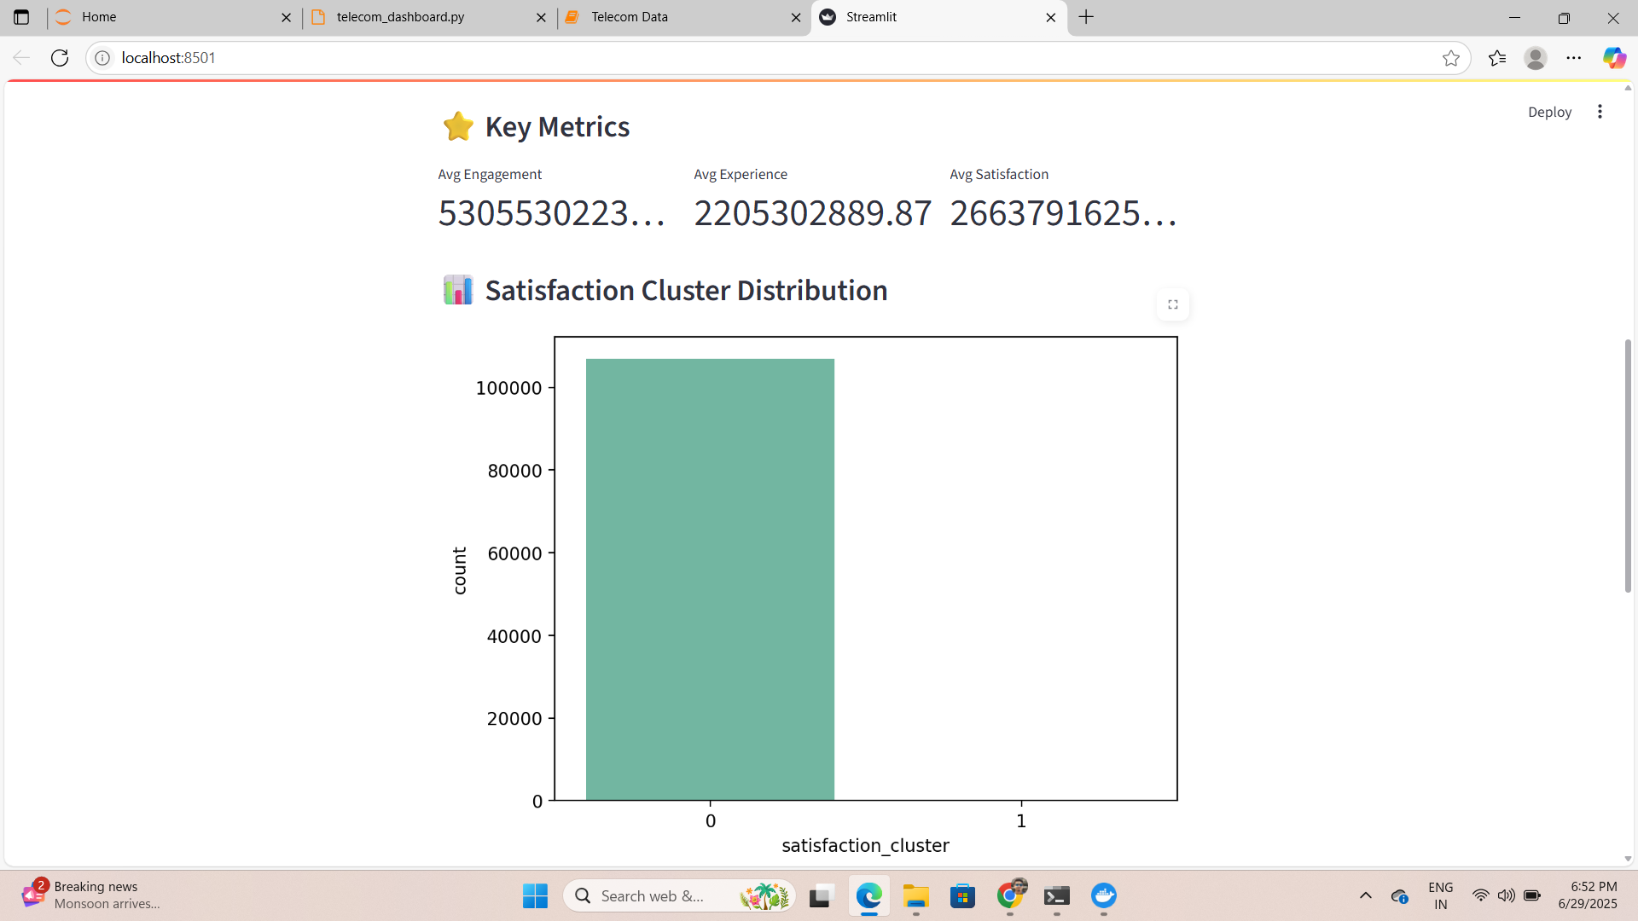
Satisfaction Analysis
Model Tracking for all the data is created and shown.
Link- streamlit run telecom_dashboard.py
Link- mlflow ui

Slide 19
Key Insights
Based on the telecom data analysis, the company demonstrates a positive growth potential, but with certain conditions:
High User Engagement: A significant number of users show high engagement based on usage metrics like total duration, traffic volume, and session count.
Strong Demand for Data: Users with devices from brands like Apple and Samsung demonstrate substantial data consumption, indicating a continued demand for mobile services.
Opportunities in Broadband: Huawei's dominance in fixed wireless routers (B528S-23A) signals growth potential in the home broadband or fixed wireless market, especially as remote work and online entertainment increase.
Positive Indicators: Large, Diverse User base, Data driven growth with rising mobile and home broadband usage and Multiple customer segments (highe end and budget users).
Limitations- Missing user demographics, Limited Time frame, No competitive comparison, Device centric analysis, Lack of Revenue/Cost Data.

Slide 20
Recommendation
Acquisition is recommended if the financial checks align, but service quality improvements and marketing to upgrade older device users should be priorities.
The user base shows strong growth potential, especially in mobile data and fixed wireless segments.
However, due diligence is required to assess financial health (revenue, debt, costs) and customer churn rates.
Focused investment in network optimization and user experience improvement (e.g., reducing RTT, improving throughput) is crucial to retain and grow the user base.

Slide 21
THANK YOU
By-
Alankar Saxena

